Slide 1
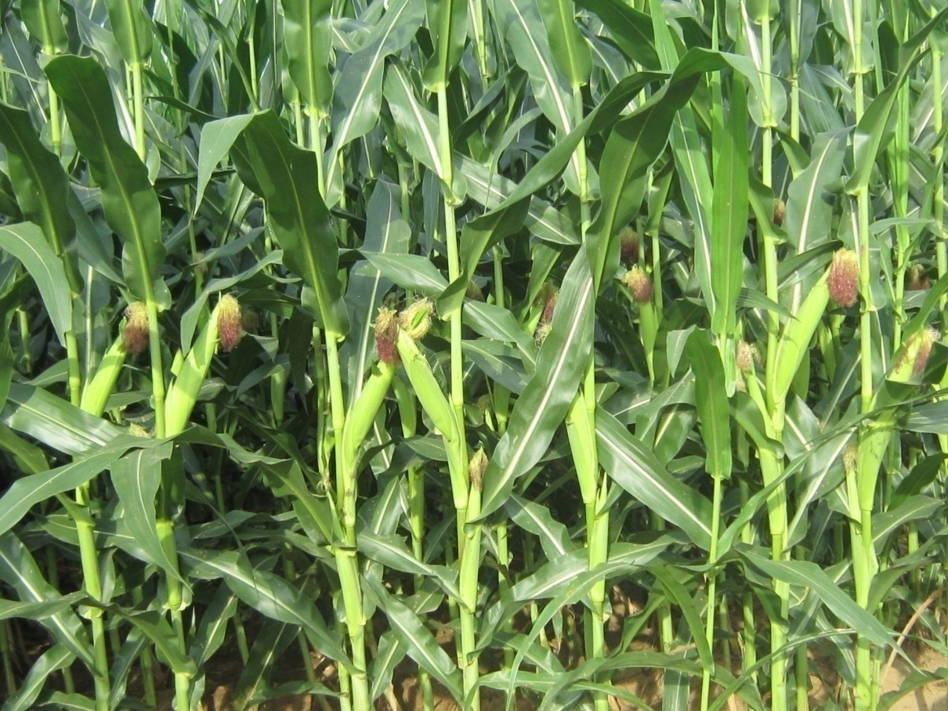
The Key to Making High-Quality Corn Silage
Dr. Walter Chen
Dairy Nutrition Consultant
Dr. Kaixing Chen
Consultant in dairy cow nutrition and ranch management

Slide 2
Outline
Nutritional value of corn silage
The process of corn silage making
Factors influencing silage quality

Slide 3
Composition of Corn Silage

Slide 4
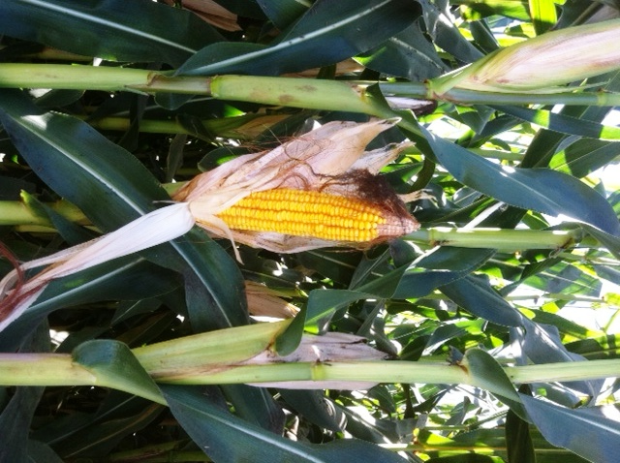
Energy Contribution
Starch 45%
NDF 25%
Sugar/VFA 10%
Protein 10%
Fat 10%
Notes:
I want to point out that corn silage, if harvest and ensiled properly, is a great source of energy. The main source of energy are coming from starch.

Slide 5
Importance of Making High Quality Corn Silage
Preserve the nutrition value of corn silage
Proper ensiling reduce dry matter losses
Promote good fermentation
Avoid production of harmful bacteria such as clostridia and mold
Increase silage stability and preservation time
Good palatability and increase dry matter intake
Improve milk production

Slide 6
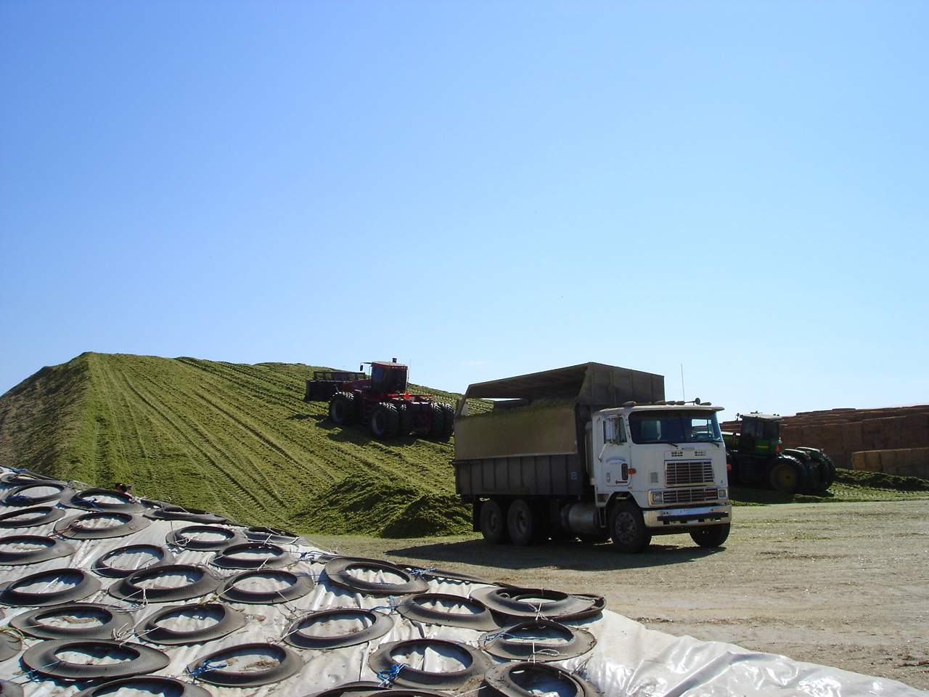

Slide 7
The Process of Silage Fermentation
Aerobic fermentation: aerobic respiration lasts from a few hours to a few days, and plant enzymes remain active until the oxygen runs out
Anaerobic fermentation: lactic acid bacteria ferment to produce lactic acid, which reduces the pH value. If the pH does not drop quickly, bad bacteria and mold will take over.
Anaerobic state: low PH, silage can be kept for a long time.
Feeding phase: The silage is re-exposed to the air, resulting in a second fermentation

Slide 8
Corn silage is like a war - to make the "good" microbes win!
"Good" microorganisms
lactic acid bacteria
"Bad" microorganisms
fungi
yeast
mold
Enterobacteriaceae
Clostridium
bacillus

Slide 9
Fermentation Process of Corn Silage
"Good" microorganisms
Sugar is used to produce a large amount of lactic acid, which causes the pH value to drop quickly.
"Bad" microorganisms
Compete with "good" microbes for food
Degrade nutrients
Generating too much heat
Toxin production

Slide 10
How to limit the growth of "bad" microorganisms?
Evacuate air quickly
Lactic acid is quickly produced, reducing the pH value
Inhibits the growth of fungi and yeasts
Prevent air from entering the silage pile (compaction and diaphragm)
Silage additives are added to accelerate the fermentation of silage

Slide 11
Factors influencing the quality of corn silage
Variety
Maturity & moisture
CuttingHeight
Kernel Processing
Packing Density
Bunker Covering
Covering
Silage additives

Slide 12
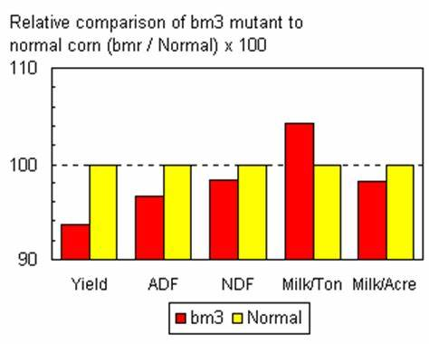
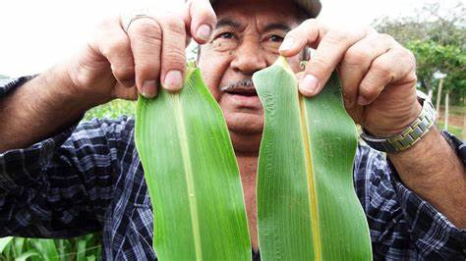
Variety
There are many silage hybrids, mainly to improve the digestibility of NDF without reducing the content of corn starch
The selection of domestic varieties is relatively limited
The digestibility of NDF was significantly improved in foreign brown mesophyllic varieties, but the yield per mu decreased

Slide 13
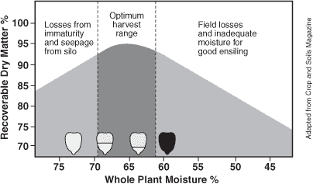
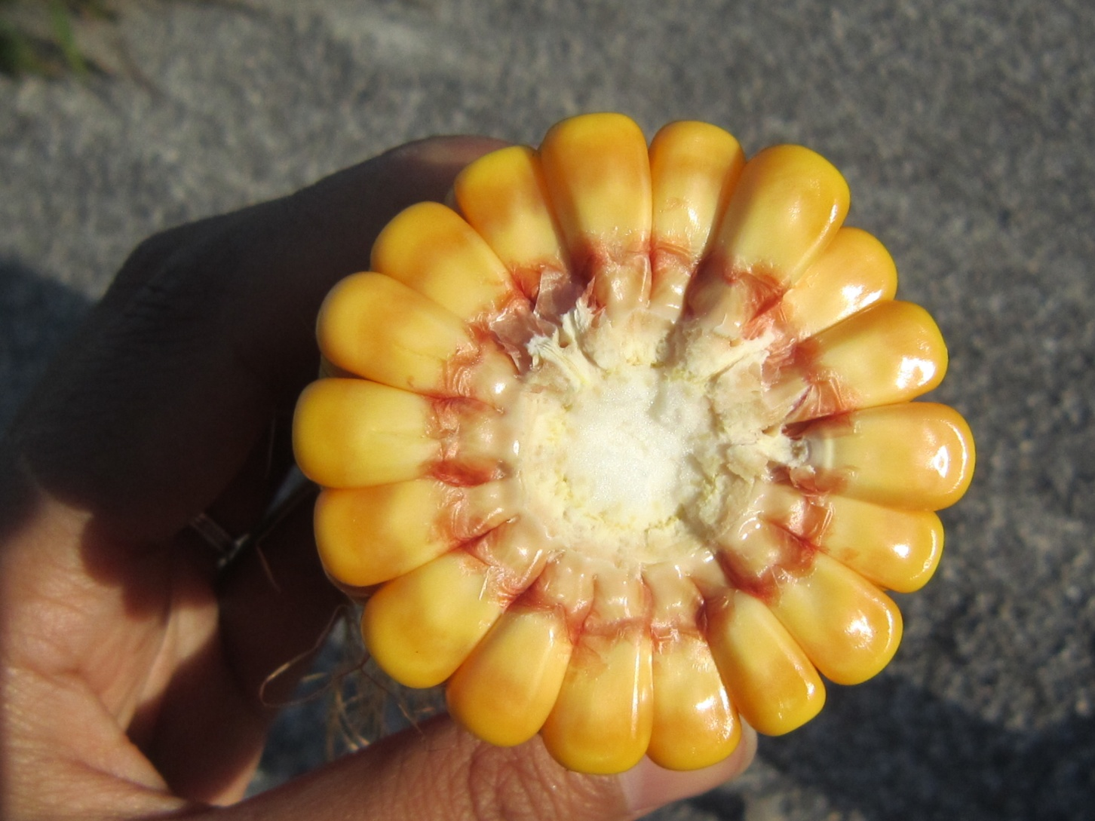
Effect of maturity at harvesting on the dry matter loss of silage

Slide 14
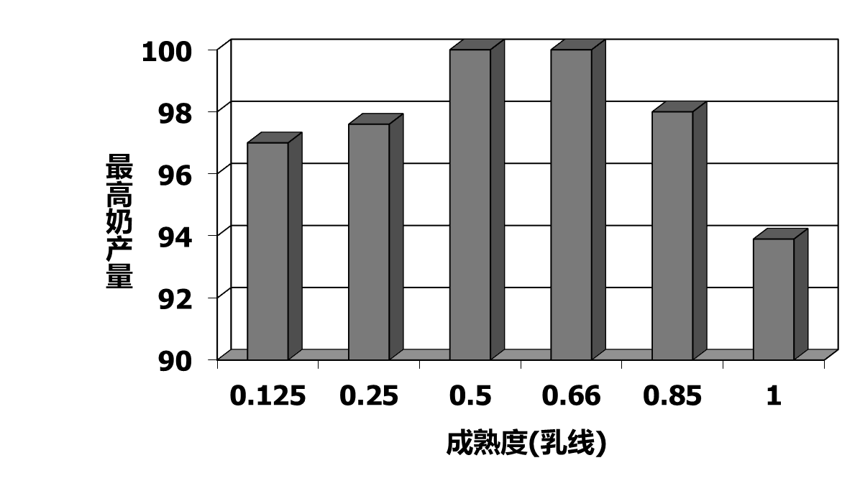
Effect of silage harvest maturity on milk production
Bal1996 and Harrison 1997

Slide 15
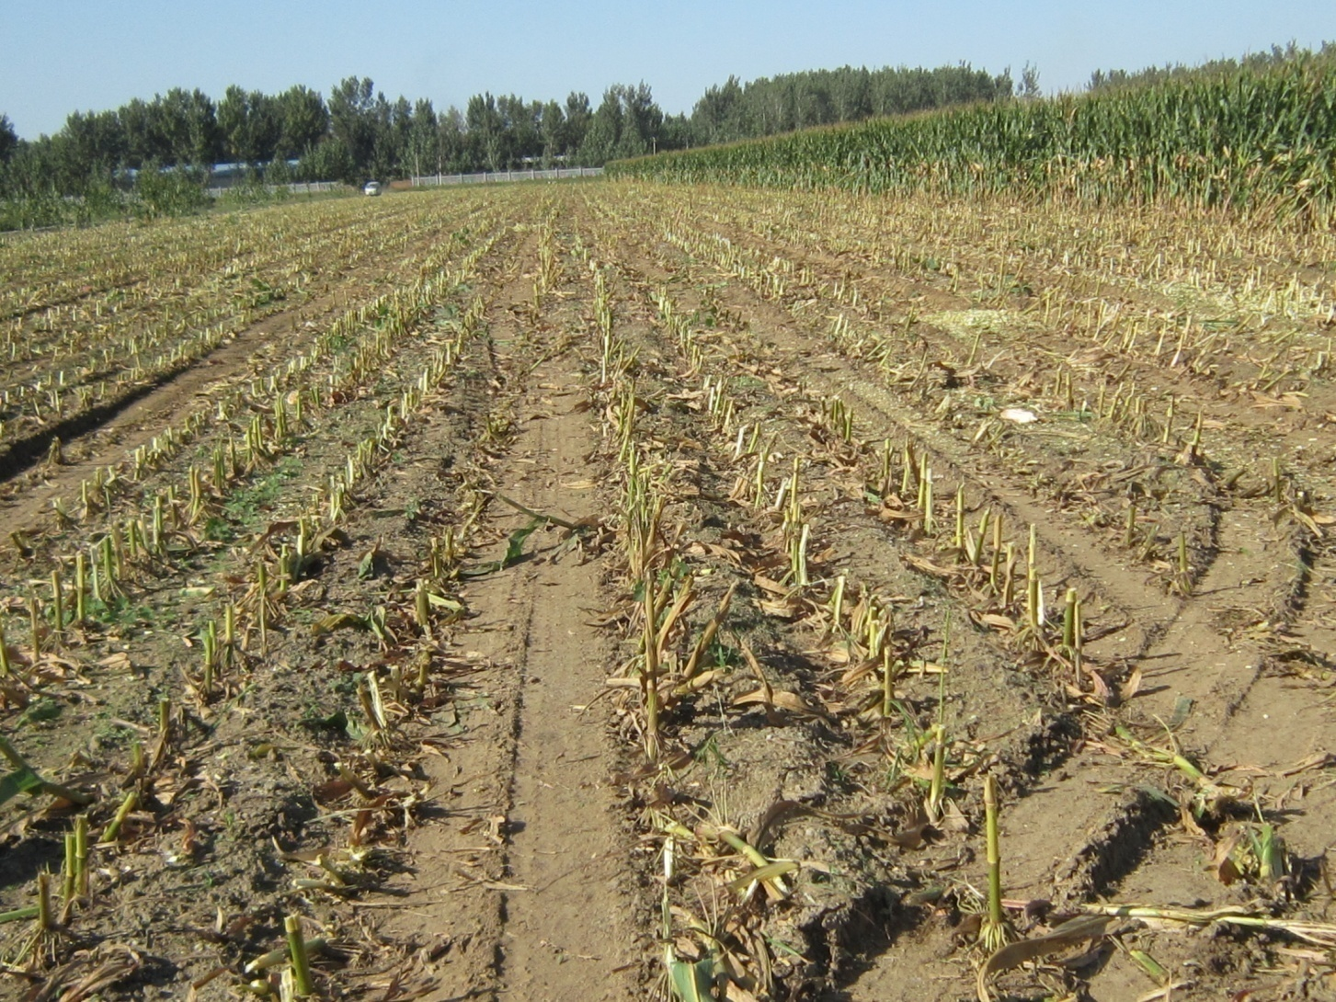
Effect of Cutting Height on Corn Silage Quality
(average of 7 trials) Wu and Roth, 2003 PSU
project | low (18cm) | high (50cm) | difference (%)
Neutral Detergent Fiber % | 41.6 | 38.0 | -8.7
Starch % | 31.4 | 33.5 | +6.7
Crude Protein % | 6.9 | 7.1 | +2.3
Net milk production, mcal/kg | 1.56 | 1.63 | +4.5

Slide 16
Design of Silage Bunker
The silage bunker design depends on the size of the pasture and the speed at which the silage is harvested
The common silage cellar is a three-walled silage cellar, and large pastures often use the ground-type silage method, mainly to reduce the cost of the silage cellar, but due to the poor pressure cellar, it often causes serious silage losses
Sausage-style plastic film bags are rarely used because of the relatively high cost, mainly for higher-value alfalfa silage

Slide 17
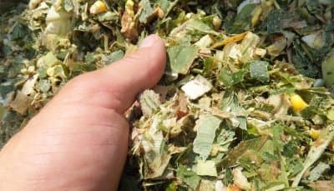
Theoretical cutting length of corn silage
No kernel processing: 1 cm
Kernel processing: 2 cm
Shredlage: 2.5cm

Slide 18
Benefits of Kernel Processing
Improves nutritional value
Reduces sorting
Better compaction
Improves starch digestibility, especially when the dry matter exceeds 35%

Slide 19
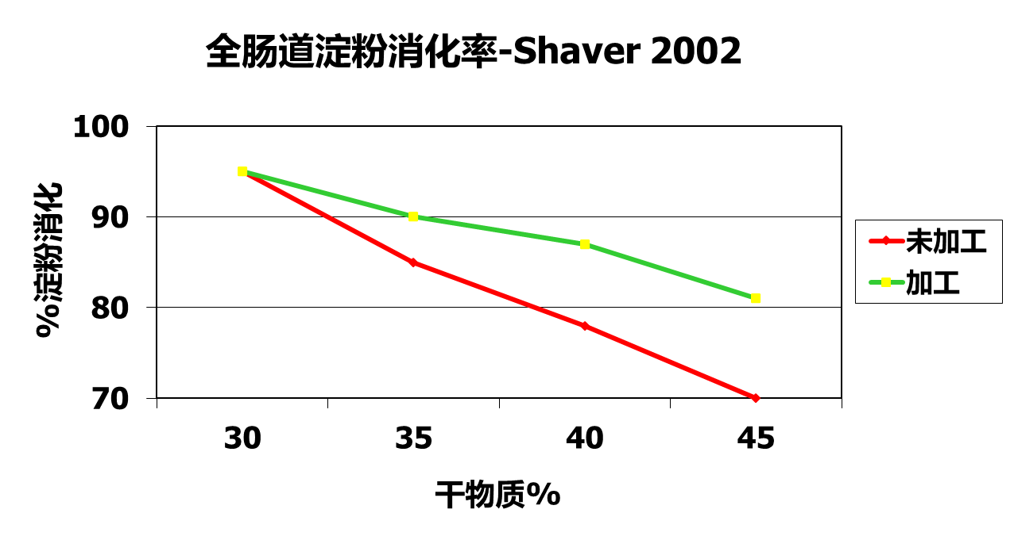
When is kernel processing most effective?

Slide 20
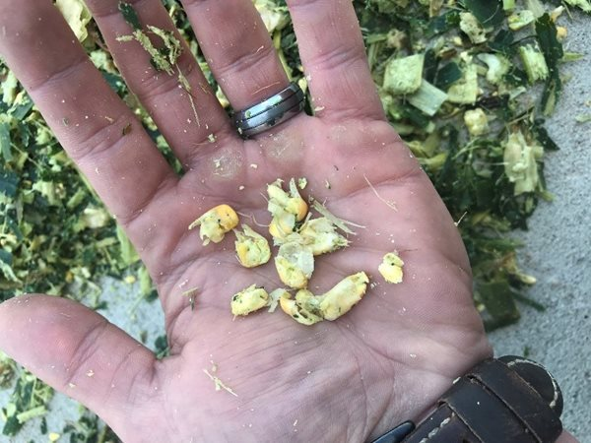
The degree of kernel processing
> 99% of corn kernels are crushed or flattened
The corn cob is crushed to the size of a coin or less
The drier and more ripe corn needs to be crushed!

Slide 21
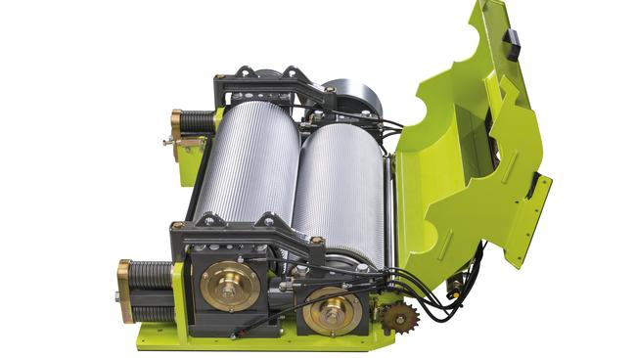
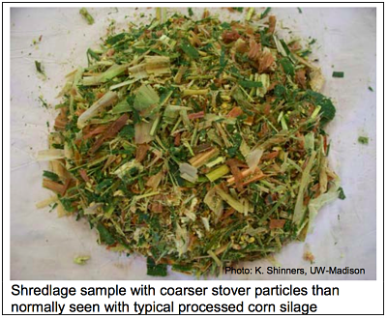
Corn Shredlage
Shredlage process is a corn silage processing method invented and developed by two American nutritionists, Roger Olsen and Ross Dale
Mainly by changing the speed of the two rollers, the effect of drawing is produced, which makes the silage fiber easier to digest after being drawn

Slide 22
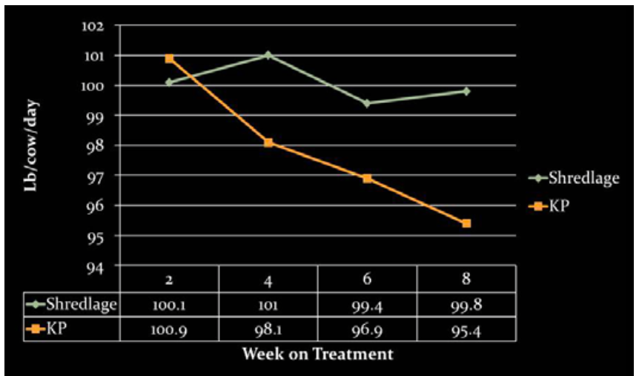
Shredlage increases milk production
Ferraretto and Shaver 2011

Slide 23
Are lactic acid bacteria needed?
Reduces the time for aerobic fermentation and thus less dry matter loss
Lowers PH, raises lactic acid, lowers acetic acid, butyric acid and mold
Moran and Owen (1999) summarized a study of 14 dairy herds and showed that the addition of Lactobacillus phytate MTD1 increased dry matter intake by 4.8% and milk yield by 4.6%
In beef cattle research, 19 studies demonstrated an 8% increase in feed intake and 11.1% daily weight gain.
Lactic acid bacteria such as Lactobacillus brucei provide acetic acid content, which is beneficial for stability after cellaring, and it has also been reported to have good results, and more research is needed
Adding lactic acid bacteria is not a substitute for good silage management!

Slide 24
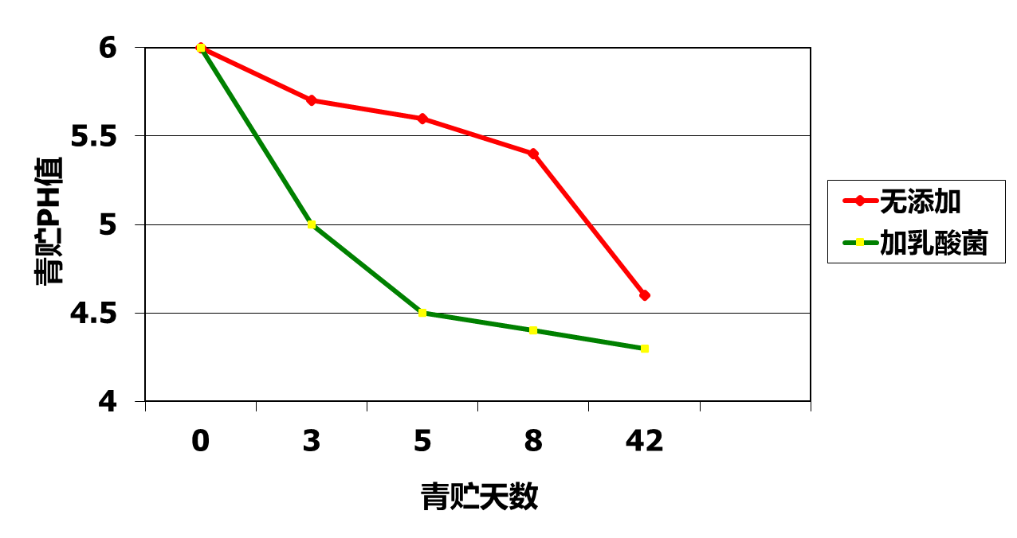
The addition of lactic acid bacteria can speed up the fermentation of silage
Lynch and Kung 2000

Slide 25
Types of silage additives
Homotyped fermented lactic acid bacteria: the product lactic acid, in the first stage of silage fermentation to speed up the fermentation rate, reduce PH, common lactic acid bacteria such as Lactobacillus phytate, Lactobacillus acidophilus, Pediococcus lactis, Pediococcus pentose, Enterococcus faecium
Lactic acid bacteria with heterotypic fermentation: lactic acid, acetic acid, CO2, such as Lactobacillus brucei
There are many hybrid products on the market, so you have to choose according to your needs

Slide 26
Silage Packing Density
The optimal silage density is 240-272 kg dry matter or 700-780 kg wet weight/m3, and the density below 225 kg dry matter/m3 will result in a loss of 17-20% dry matter
The thickness of the silage is 15 cm per layer when pressing, and it is too thick to be compacted
Heavy-duty forklifts or tractors are employed
Control the speed at which the silage is put into the bunker and the time it takes to press the silage
Seal the bunker as soon as possible (within 1-2 days)

Slide 27
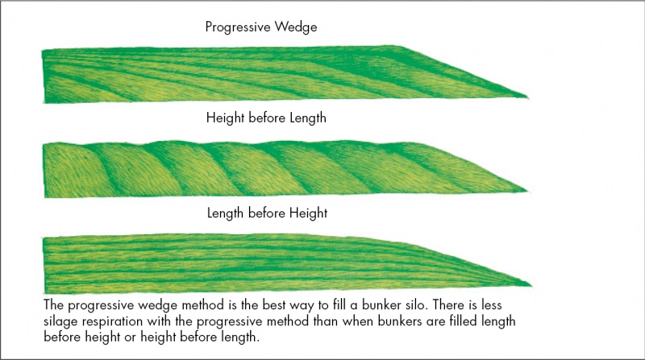


Filling the Bunker

Slide 28
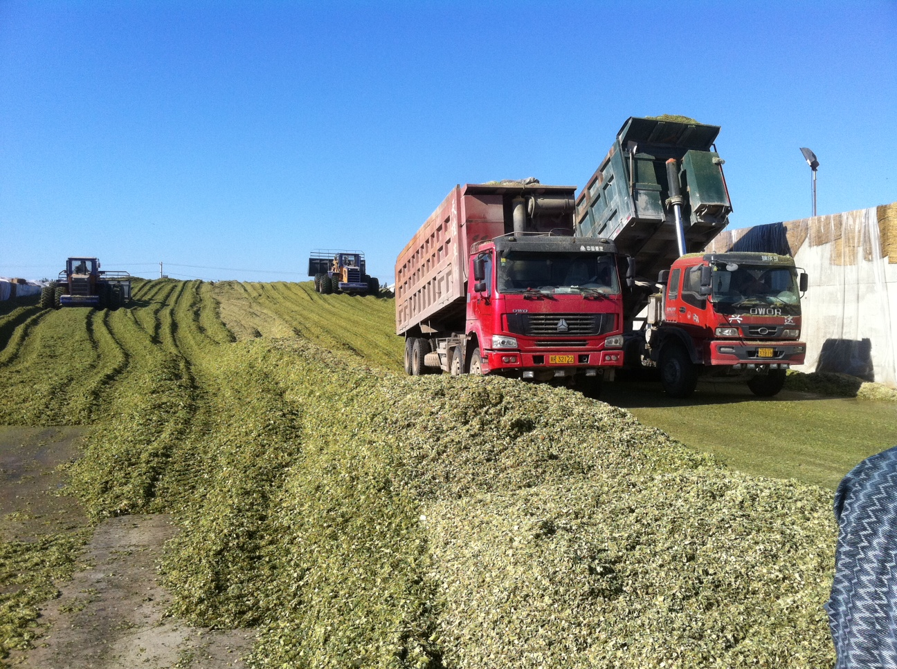

Slide 29
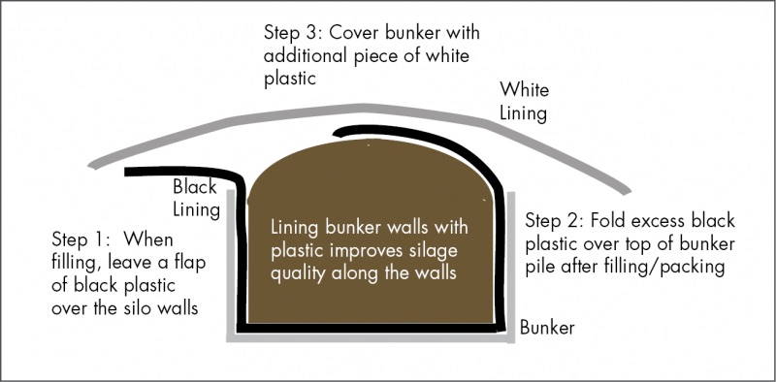
Covering Bunkers

Slide 30
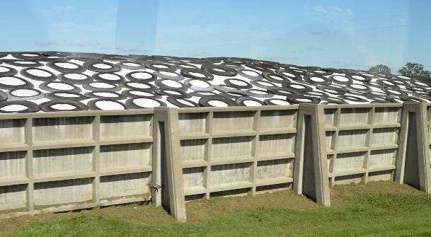
Oxygen barrier membrane
Compared to ordinary plastic films, the oxygen barrier film reduces dry matter losses by an average of 8%.
(Results of 41 studies)
The oxygen barrier film (1.8mm) should be used at the same time as the silage black and white film for the best effect

Slide 31
Nutritional Targets for Corn Silage
 | Range | Target
Crude Protein (CP) | 8-9.5% | >8%
Acid Detergent Fiber (ADF) | 25-35% | <30%
Neutral Detergent Fiber (NDF) | 35-55% | <40%
NDF digestibility (NDFD 30 h) | 44-65% | >57%
Starch | 18-44% | >30%
Net lactation energy (NEL) | 1.32-1.55兆卡/kg | >1.50
Milk yield, kg/ton DM | 1100-1600 | >1500
Ash content | 3-11% | <5%
Lactic acid | 2-9% | >6%
Acetic acid | 0.5-8% | <3%

Slide 32
Acid Profile of Corn Silage
PH ：3.5-4.2
Lactic acid: 4-8%.
Acetic acid: less than 3%.
Propionic acid: 0-1%.
Butyric acid: none
Ammonia nitrogen: less than 5%.

Slide 33
Summary
The best time to harvest corn is at 1/2-2/3 milk line, with 32-35% dry matter
The theoretical cutting length with kernel processing is 2 cm
Kernel breakng should reach more than 99%.
Increase the cutting height to improve fiber digestibility
Compaction: densities up to 250-270 kg dry matter per cubic meter
Consider adding lactic acid bacteria
Oxygen barrier membrane is recommended

